Slide 1





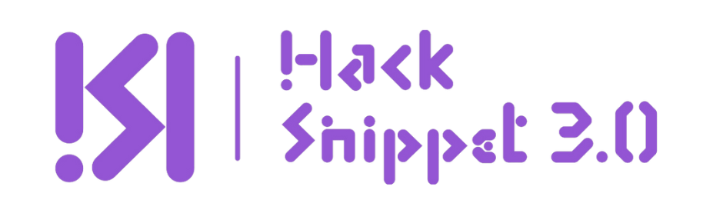
Team name: ByteBandits
Team member details:
Swastik Manna - T – 47
Rajeet Ash - T – 50
Debolina Singha - T – 45
Barshan Nashkar - T – 46
Sk Sazid Ahammed - T - 48

Slide 2
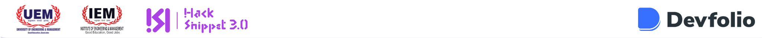

Assignment Assistant: Your Offline Academic Buddy
PROBLEM
Students face stress and often miss assignment deadlines due to poor time management.
SOLUTION
A website that helps students:
Stay on top of deadlines.
Solve assignments efficiently.
Humanize responses to appear natural.
WHY IT IS UNIQUE?
It runs entirely offline using a local LLM, ensuring privacy and accessibility without internet reliance.

Slide 3
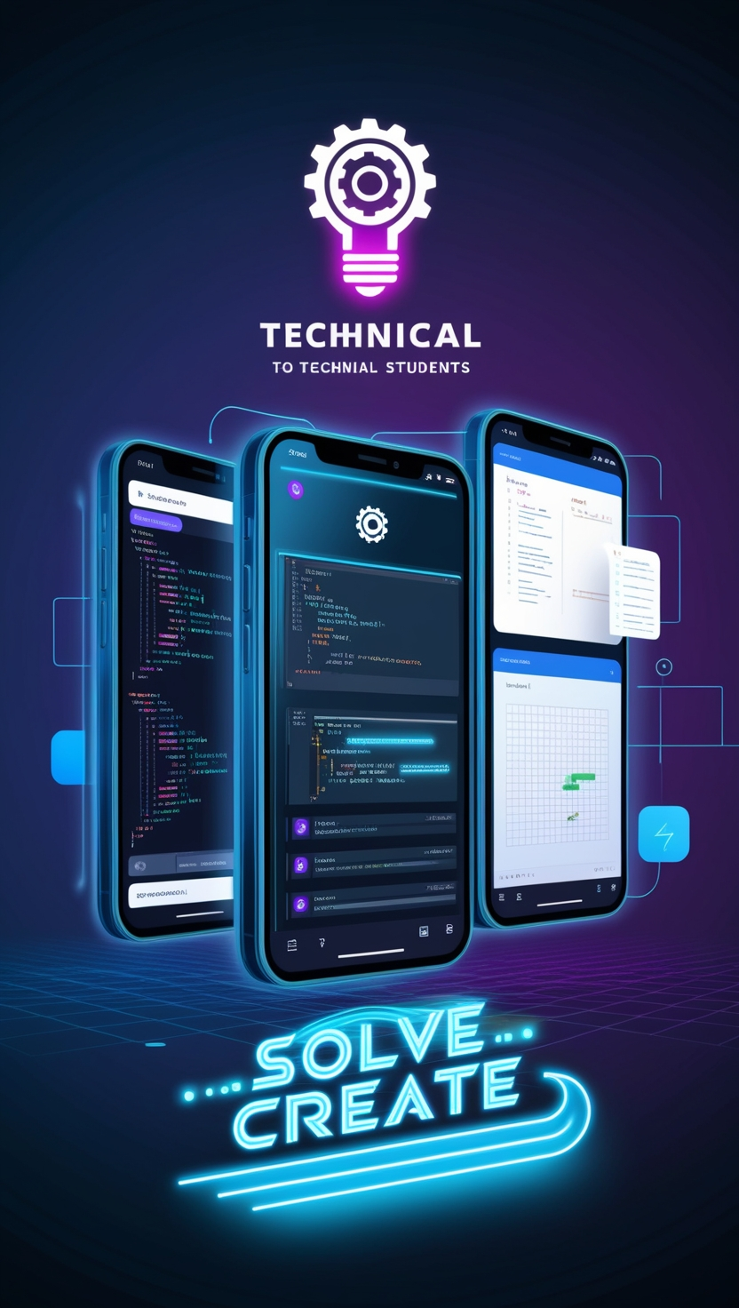


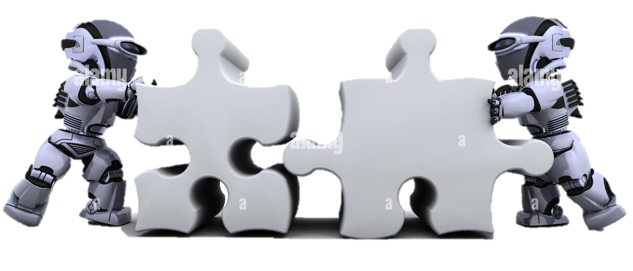
APPROACH
PROPOSAL
SOLUTION
Core Focus:
Simplify assignment management for students.
How It Works:
Students input assignments and deadlines.
The website reminds them ahead of time.
The LLM solver generates solutions in human-like language.
Best Feature:
Offline operation ensures data privacy and allows use in environments with limited internet access.
Key Features:
Offline functionality for complete privacy
Local processing to eliminate dependency on external servers
Human-like tone adjustment to ensure AI responses don’t feel artificial
Example Use Case:
Input: “Write a 200-word essay on global warming.”
Output: A well-structured essay, natural in tone and ready for submission

Slide 4
Detailed Approach:
Workflow, Problems, and Solutions
KEY PROBLEMS AND SOLUTION
Input Assignment Details
Reminder System
Missed Deadlines
Solution: Timely reminders.
Robotic AI Responses
Solution: Humanized content generation.
Internet Dependence
Solution: Fully offline system.
HOW IT WORKS?
Local LLM Solver
Humanization Process
Output Generation

Slide 5

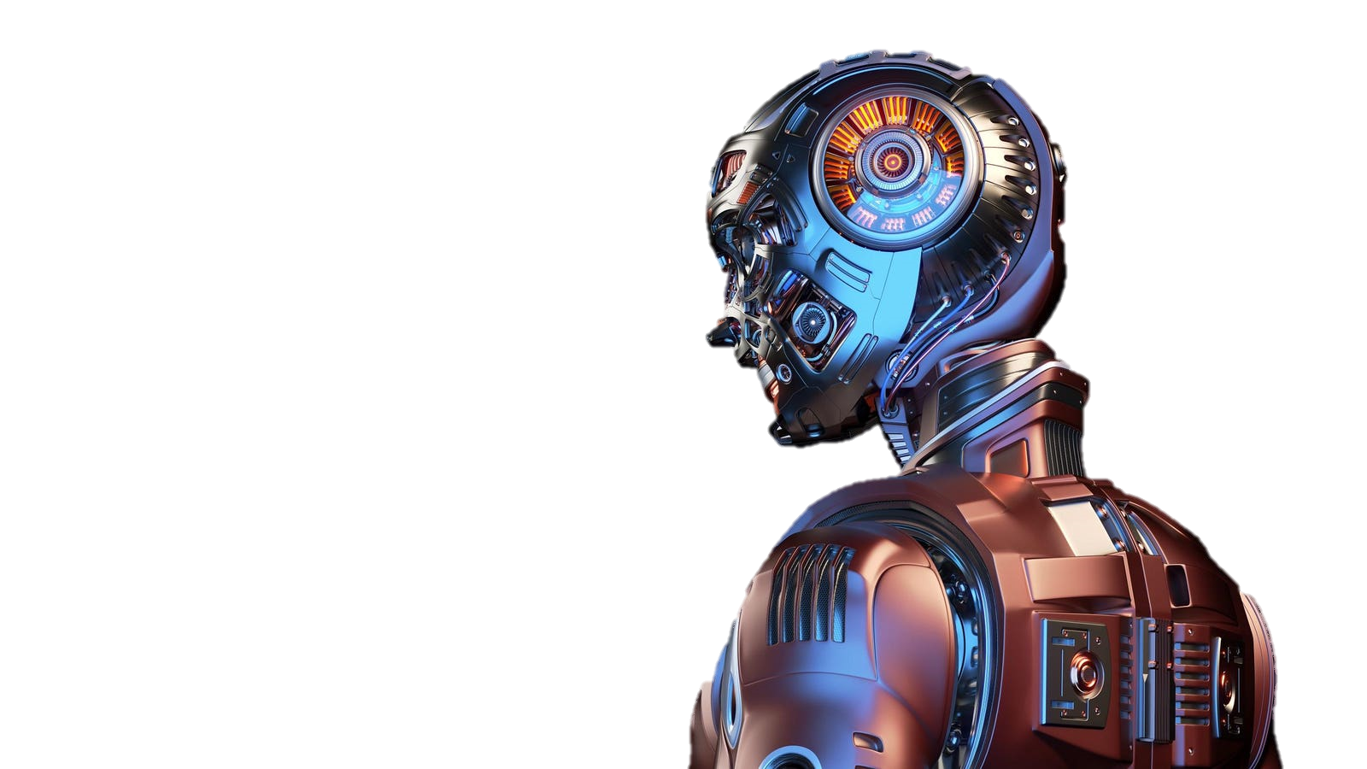
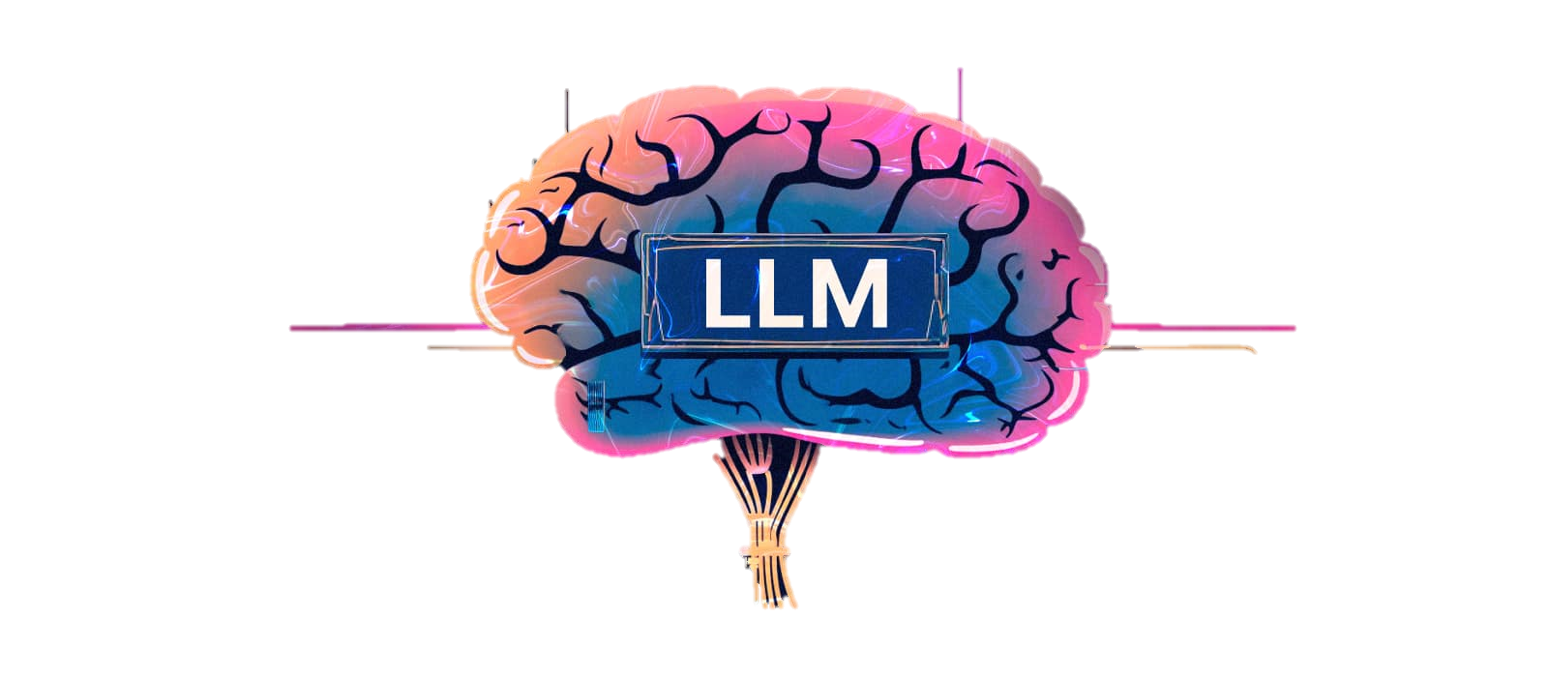
.
Tools and Devices Used
Technologies Involved
Device: Laptop (spesc- 6 core 12 thread CPU - Rtx 4060).
Libraries: transformers, torch, schedule, chroma db, plyer.
Editor: Visual Studio Code or intelliJ idea for development
NLP: Enables contextual understanding for solving assignments.
Python: Backend for the reminder system and solver.
LLM Models: Lightweight models like Llama 3.3, LLaVa 1.6 as LLM.
Flask: Creates a user-friendly web interface for interaction.
reference
Python: Python Official Website
LLM Models (e.g., Llama 3.3, LLaVa 1.6):
Llama: Meta's Llama Language Model
LLaVa: LLaVa GitHub Repository
Flask: https://flask.palletsprojects.com/en/stable/

